Slide 1
Client Access Request Management System (CARMS)
Overview and UI Showcase

Slide 2
What is CARMS?
A full-stack application for managing external client access requests.
Frontend built with React + Zustand for state management.
Backend implemented with .NET Core Web API + EF Core.
Uses OpenAPI (Swagger) for API documentation.
Supports external Notification API & Access API integration.

Slide 3
Key Features
Create, edit, and submit access requests
Role-based request approval workflow
Status tracking and notification triggers
SSO username auto-generation support
Clear UI messages and dashboards

Slide 4
Technical Architecture
React SPA frontend (Zustand for state)
C# .NET Core backend (REST API)
EF Core with in-memory DB (can scale to SQL Server/PostgreSQL)
External API integrations: Notification & Access
OIDC authentication integration ready

Slide 5
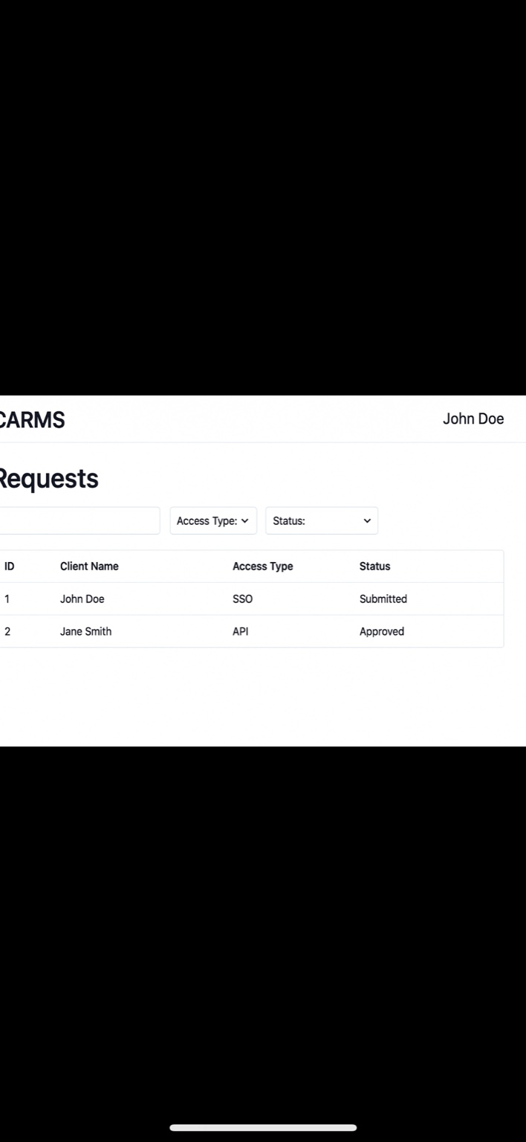
Homepage Screenshot

Slide 6
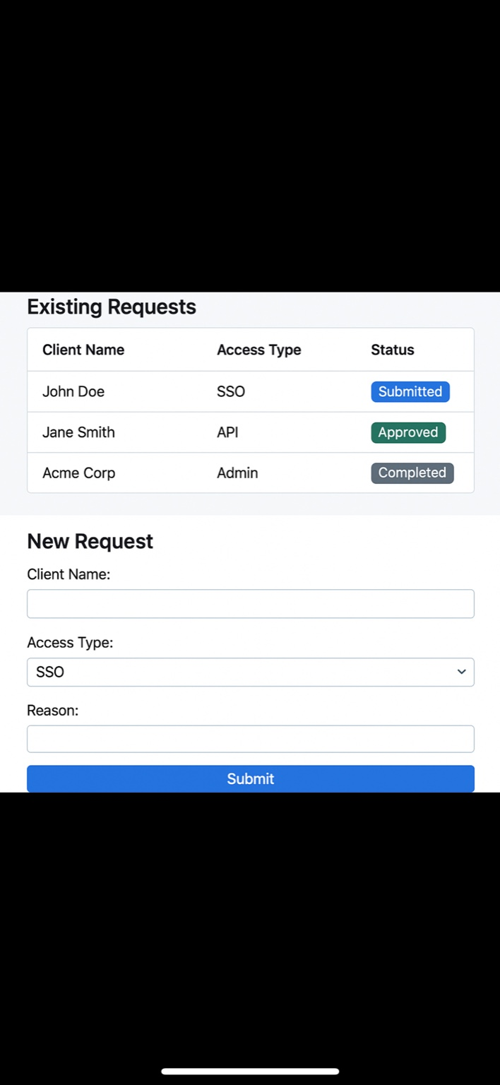
New Request Page

Slide 7
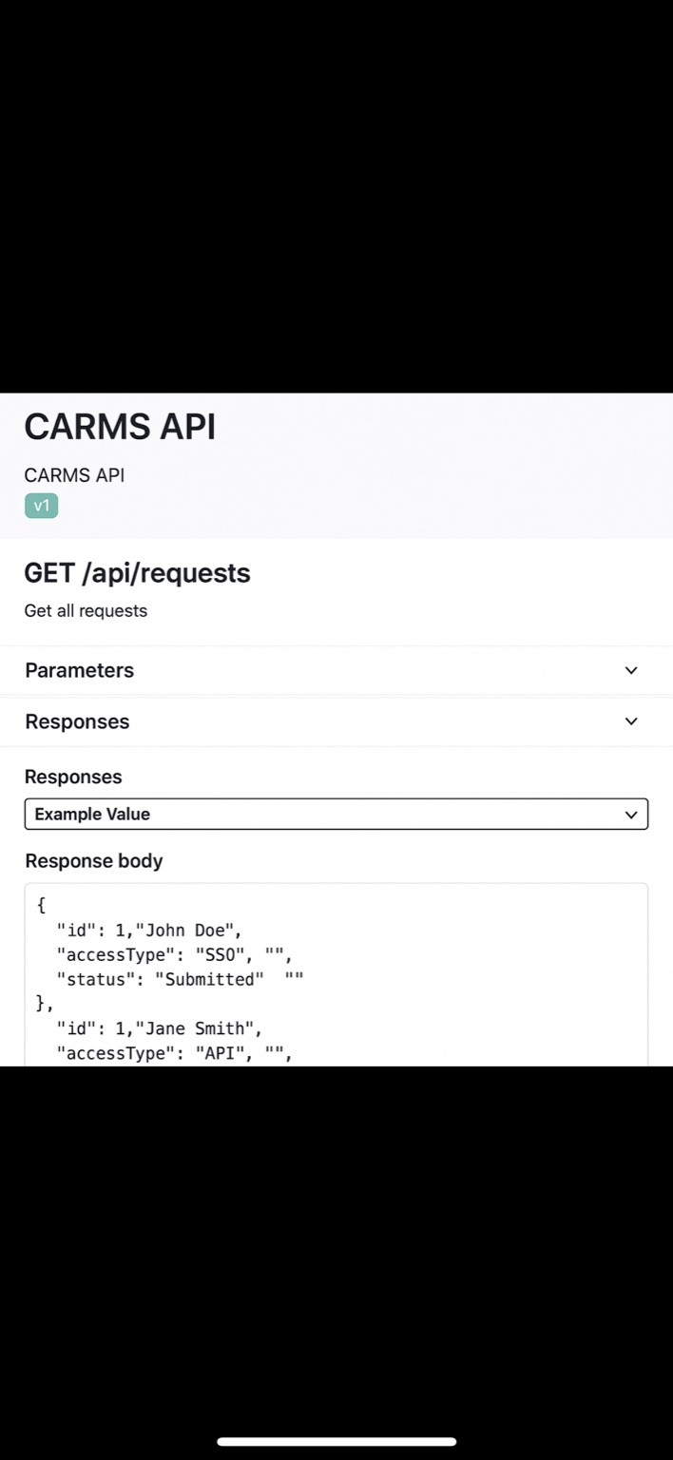
Swagger API Docs

Slide 8
Planned Enhancements
OIDC authentication (Okta/Azure AD)
Role-based dashboards and analytics
Audit logs for every action
Email and webhook notification expansion
Full Docker & CI/CD pipeline integration

